Slide 1
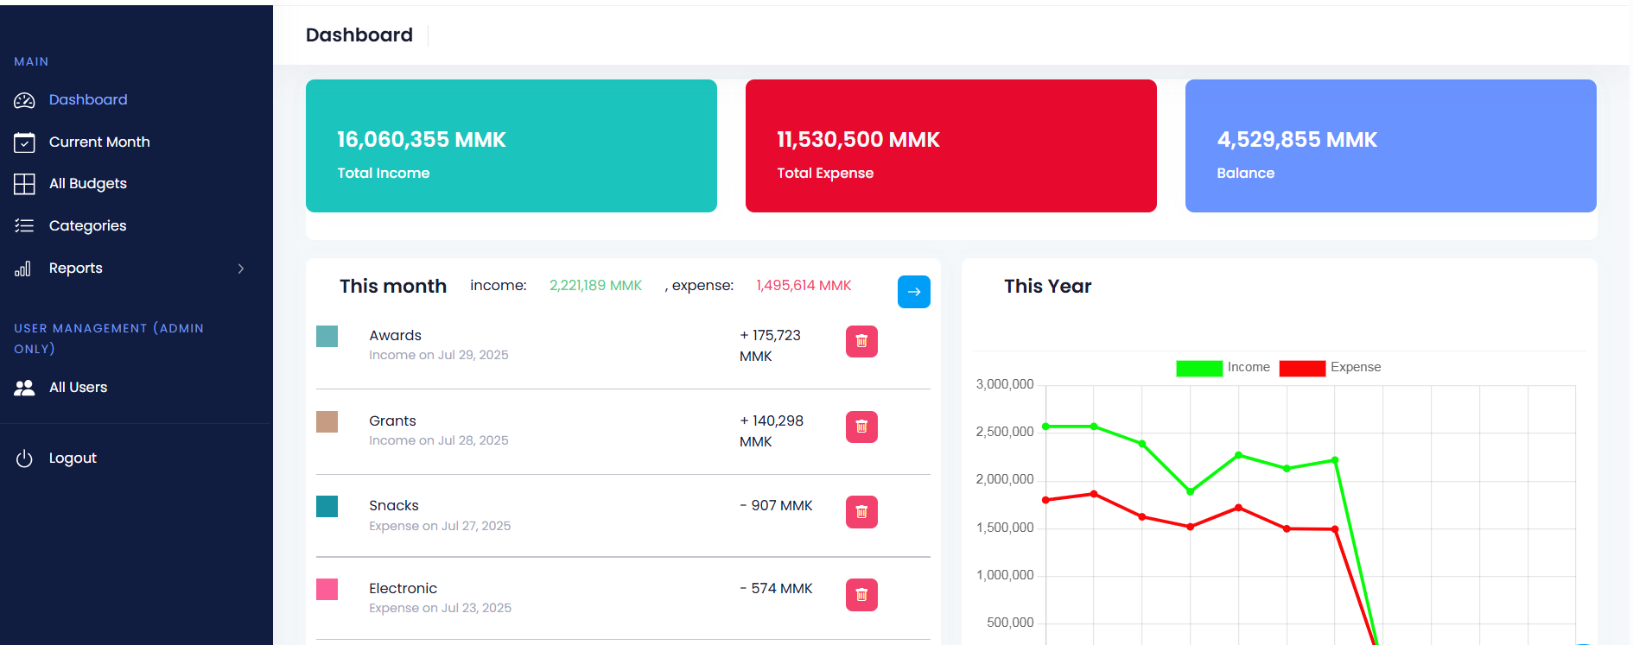
Expense Tracker System
Ma Htet Htet Zin Aye
5CS(EXT-?)
19-August-2025
Daw Mar Lar Htun Associate Professor

Slide 2
Outlines
Abstract
Introduction
Business concept
Problem Background
Purpose of the project
Objectives
Scope of the Project
System Design
Implementation
Conclusion
Lessons Learned
Further Enhancements
References

Slide 3
Abstract
The Expense Tracker Web App is a user-friendly web-based solution designed to help individuals and small businesses monitor finances efficiently.
The system enables users to record, categorize, and analyze incomes, expenses promoting better financial awareness and budgeting
Addresses challenges of manual tracking (e.g., human error, lack of spending visibility).
Key features include intuitive dashboards, usage on categorization, and data visualization
Designed with a responsive interface, ensuring seamless use across devices (desktop, tablet, and mobile).
Multiple Types of Reports
Admin can manage users’ role and status

Slide 4
Introduction
In an era of digital finance, managing personal and business income, expenses efficiently is critical for financial health.
Records may be taken in spreadsheets, but can’t analyze efficiently
This project is developed for users to save their time and resources for financial management
The system simplifies financial management with categorization incomes expenses instantly, Visualize the budgets with charts and reports.
The system Empowers users to make informed budgeting decisions, save time, and achieve financial goals

Slide 5
Business Concepts
Core Idea: A web-based budget tracking platform that simplifies personal and small business financial management.
Target Users: for all users who need streamlined budget control.
Key Features: Category Management, Budget Management, visualize charts and reports
Simple to use and analyze the budgets
Admin User Dashboard for User Management
Built using modern web technologies (Laravel)
Long-Term Vision: Expand into financial wellness and setting alerts for overcome expenses

Slide 6
Problem Background
Manual Tracking Challenges:
Most are lost without digital tools
Spreadsheets are error-prone and lack of analysis .
Existing Solutions Fall Short:
Mobile apps often lack cross-device sync or detailed reporting.
Enterprise software (e.g., QuickBooks) is overly complex
Financial Consequences:
Poor expense management leads to overspending

Slide 7
Purpose of the Project
Transform Financial Habits
Budget management with data-analyze decision-making
Break the cycle of "earn-spend-regret" through real-time awareness .
Easy and Efficient Management:
Easily manages the incomes, expenses
Categorize on Budgets:
To see easlity the amount used on each category

Slide 8
The Scope of The Project
User Management: secure sign-up/sign-in, Role-based access
Category Management: Income and expense categories with colors for visualize
Income & Expense Recording: Add/edit/delete entries
Data Visualization & Reporting: Pie charts by category & expense vs. income comparison

Slide 9
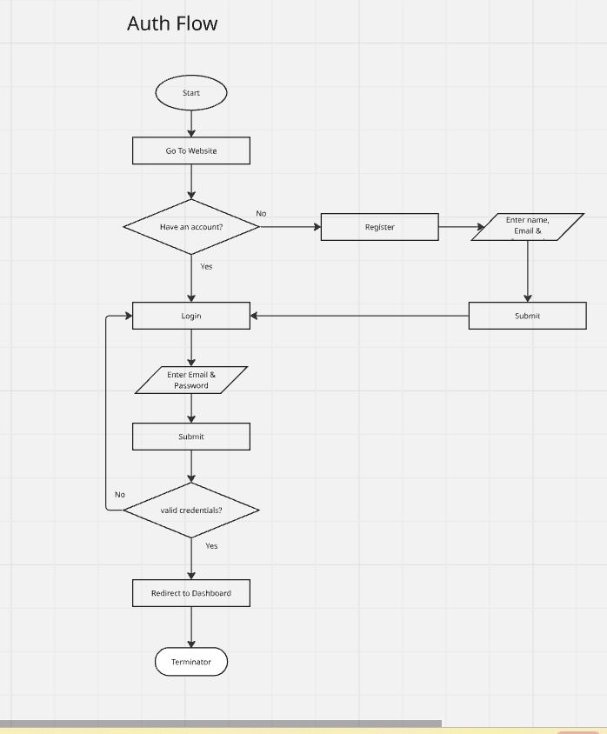
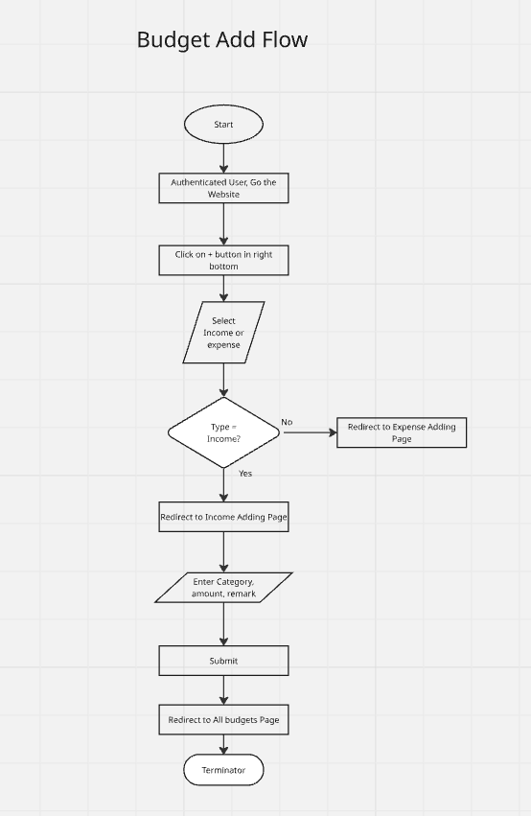
System Design
Auth Flow
Budget Add Flow

Slide 10
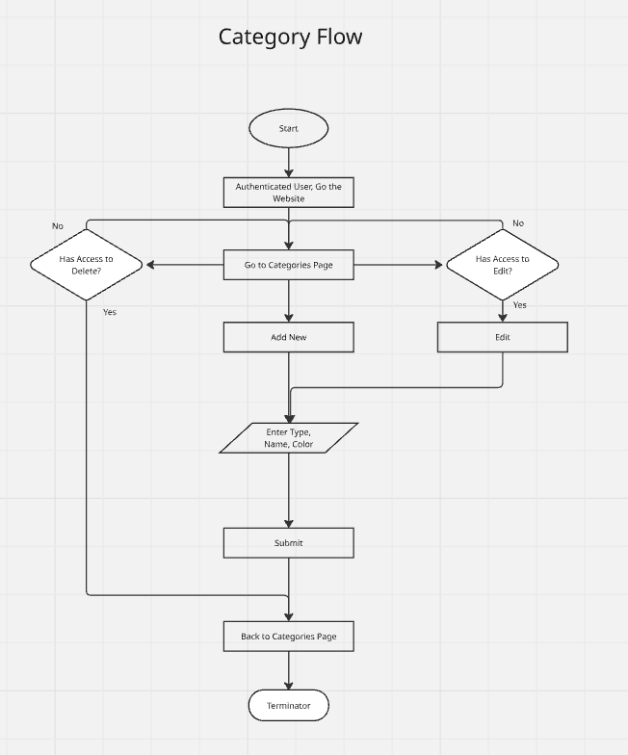
System Design
Category Flow

Slide 11
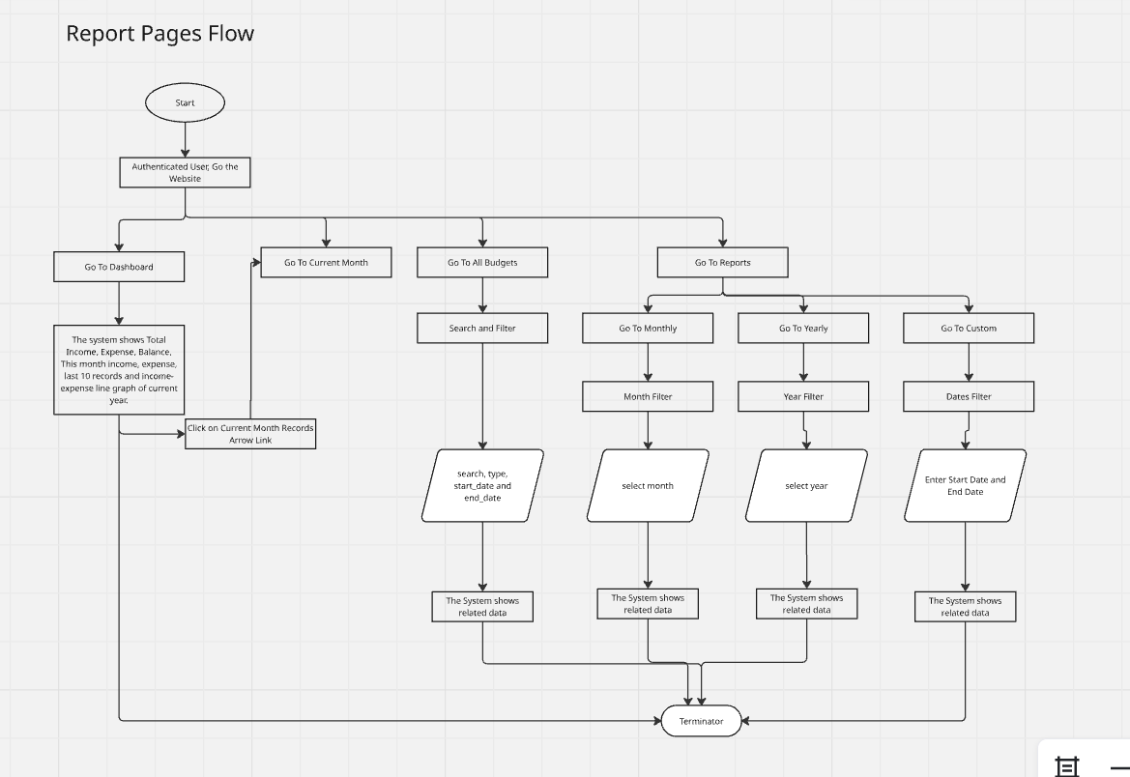
System Design
Budget Reports Pages

Slide 12
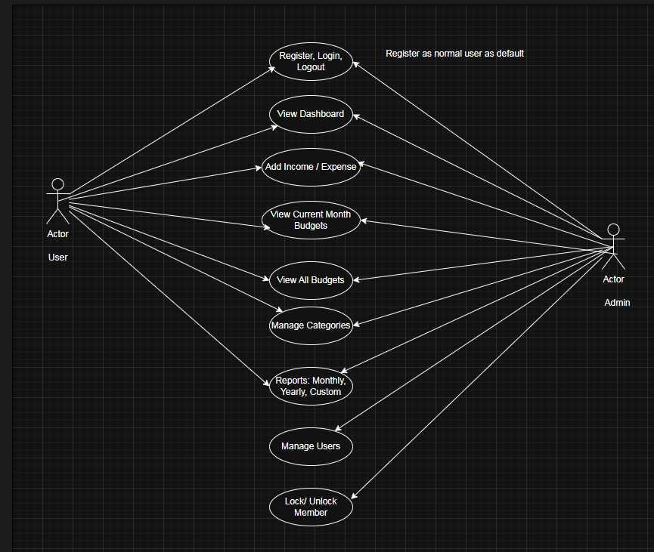
System Design
Use Case Diagram

Slide 13
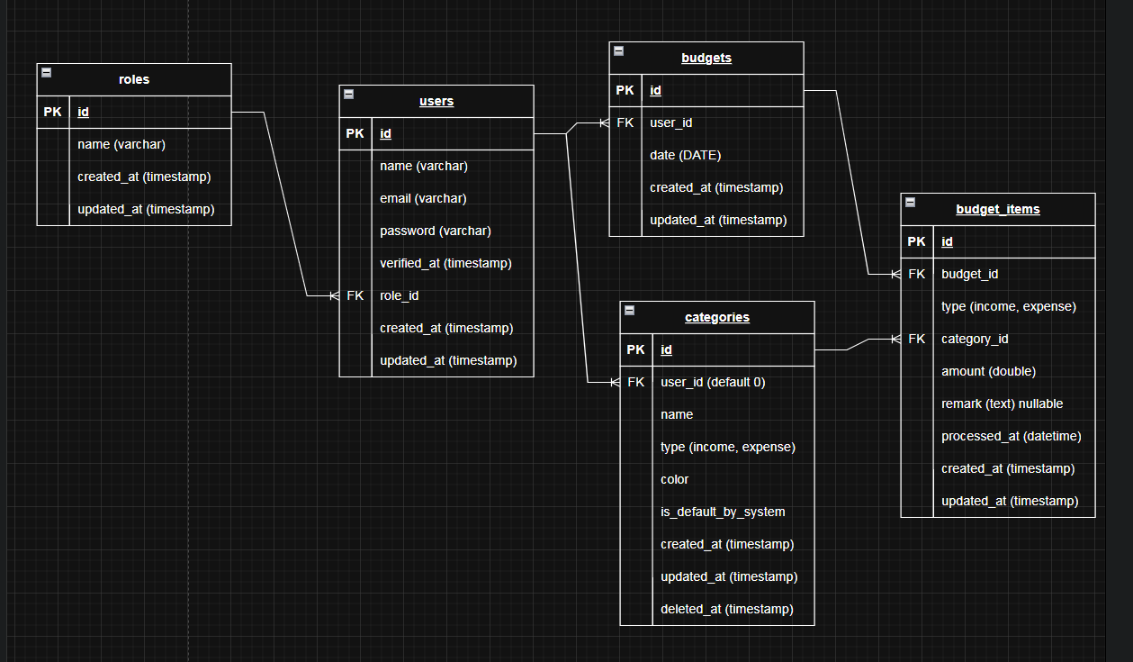
System Design
ER Diagram

Slide 14
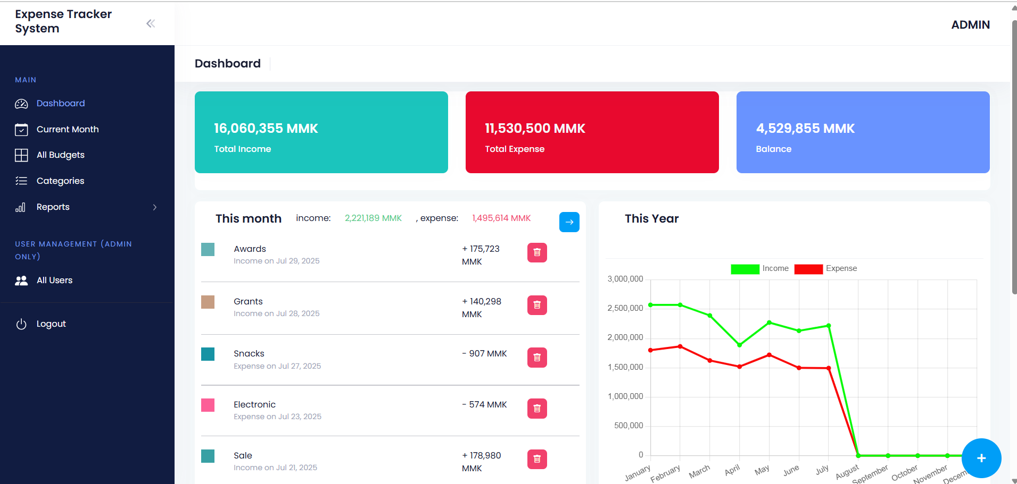
Implementation
Overview Dashboard

Slide 15
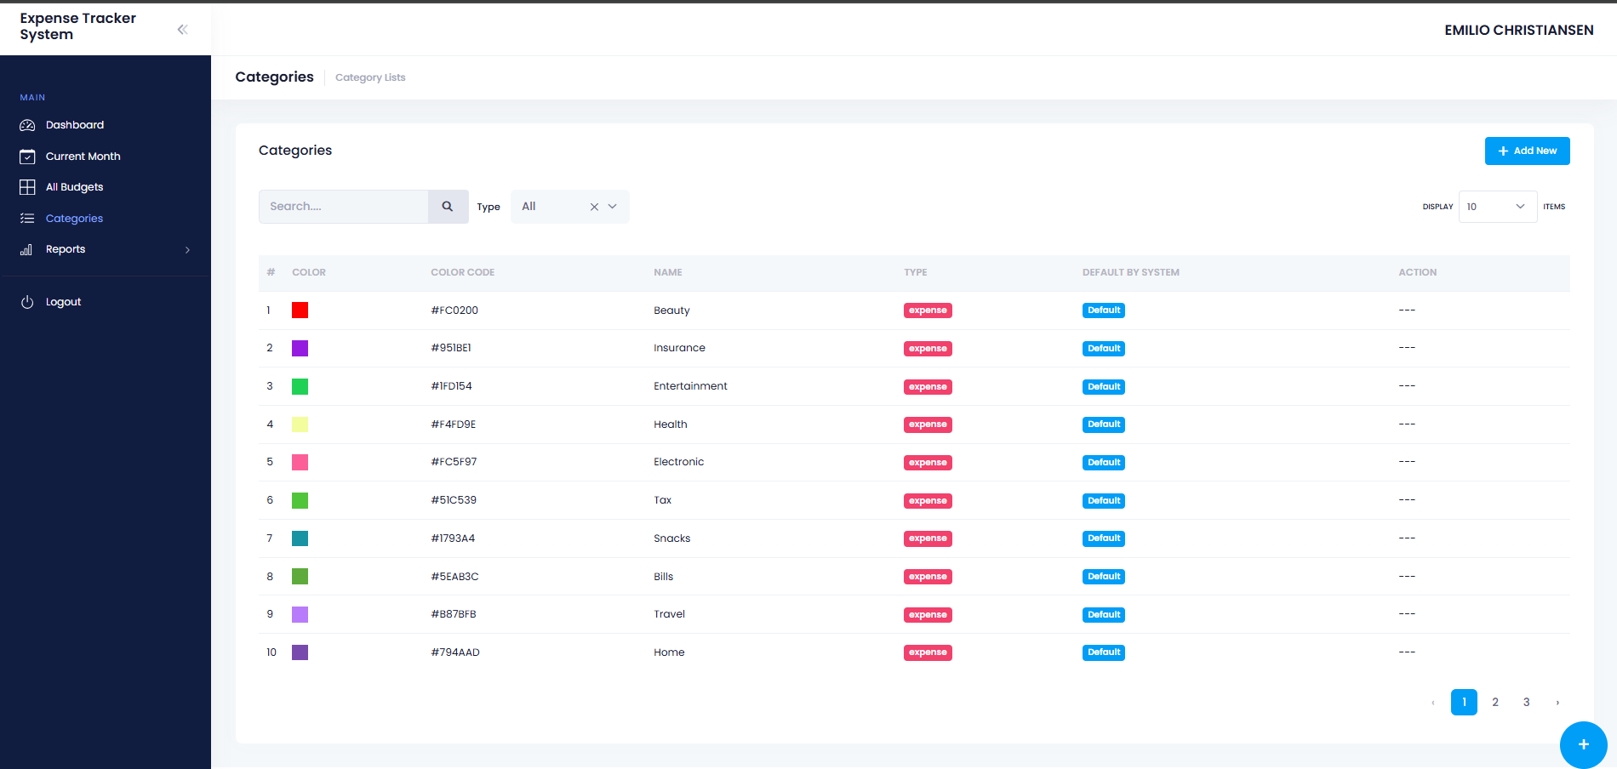
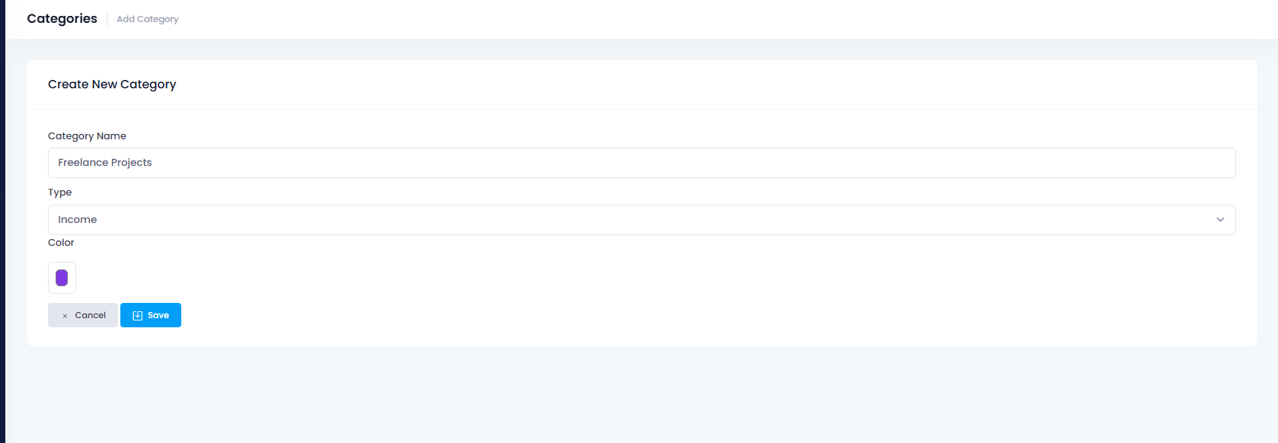
Implementation
Category Management: has default categories by the system. Those cannot be edited by normal user. User can add new like below. - color will be used in visualization.

Slide 16
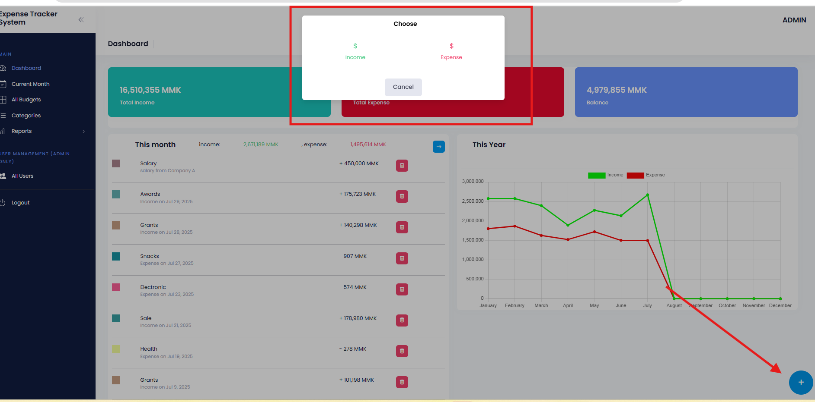
Implementation
Click on + cycle button and chose

Slide 17
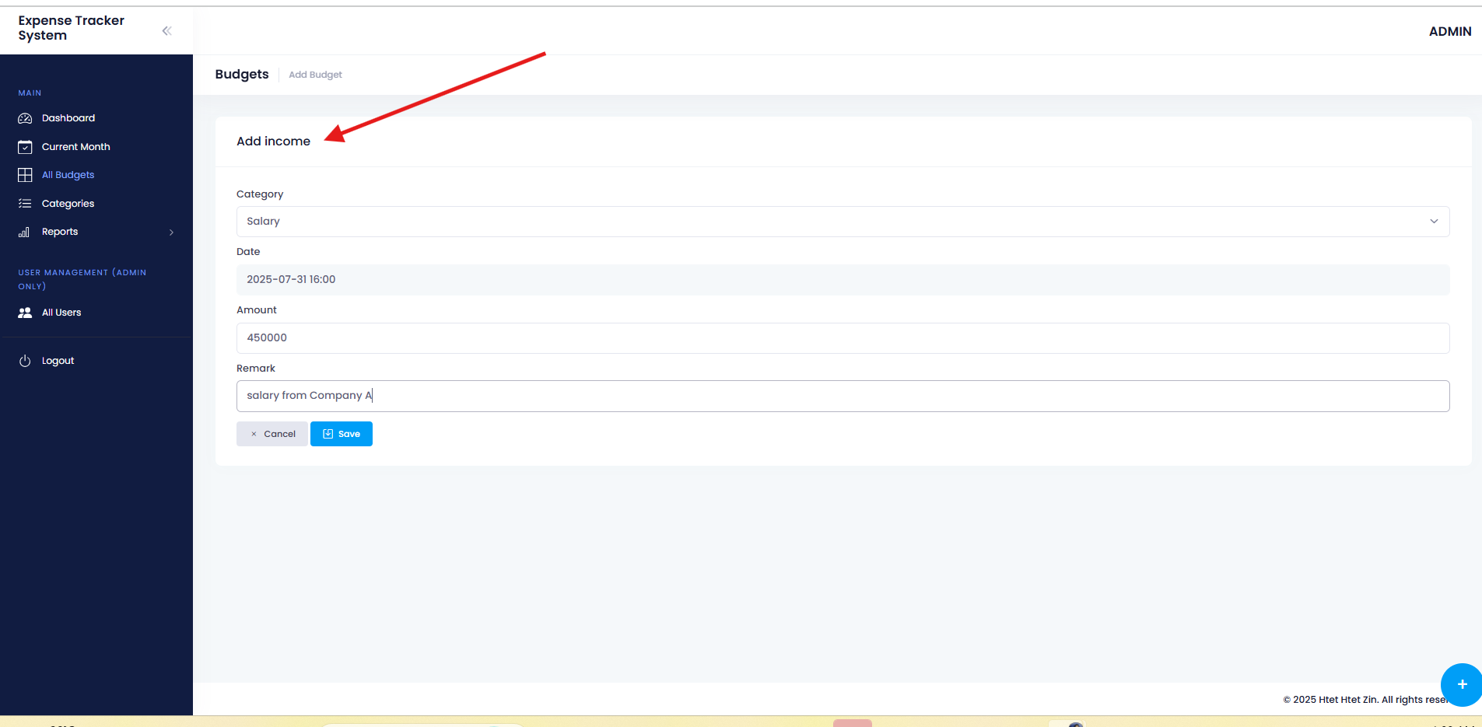
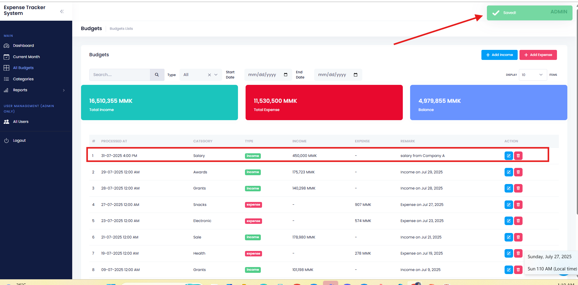
Implementation
Income adding. Expense adding process is the same.

Slide 18
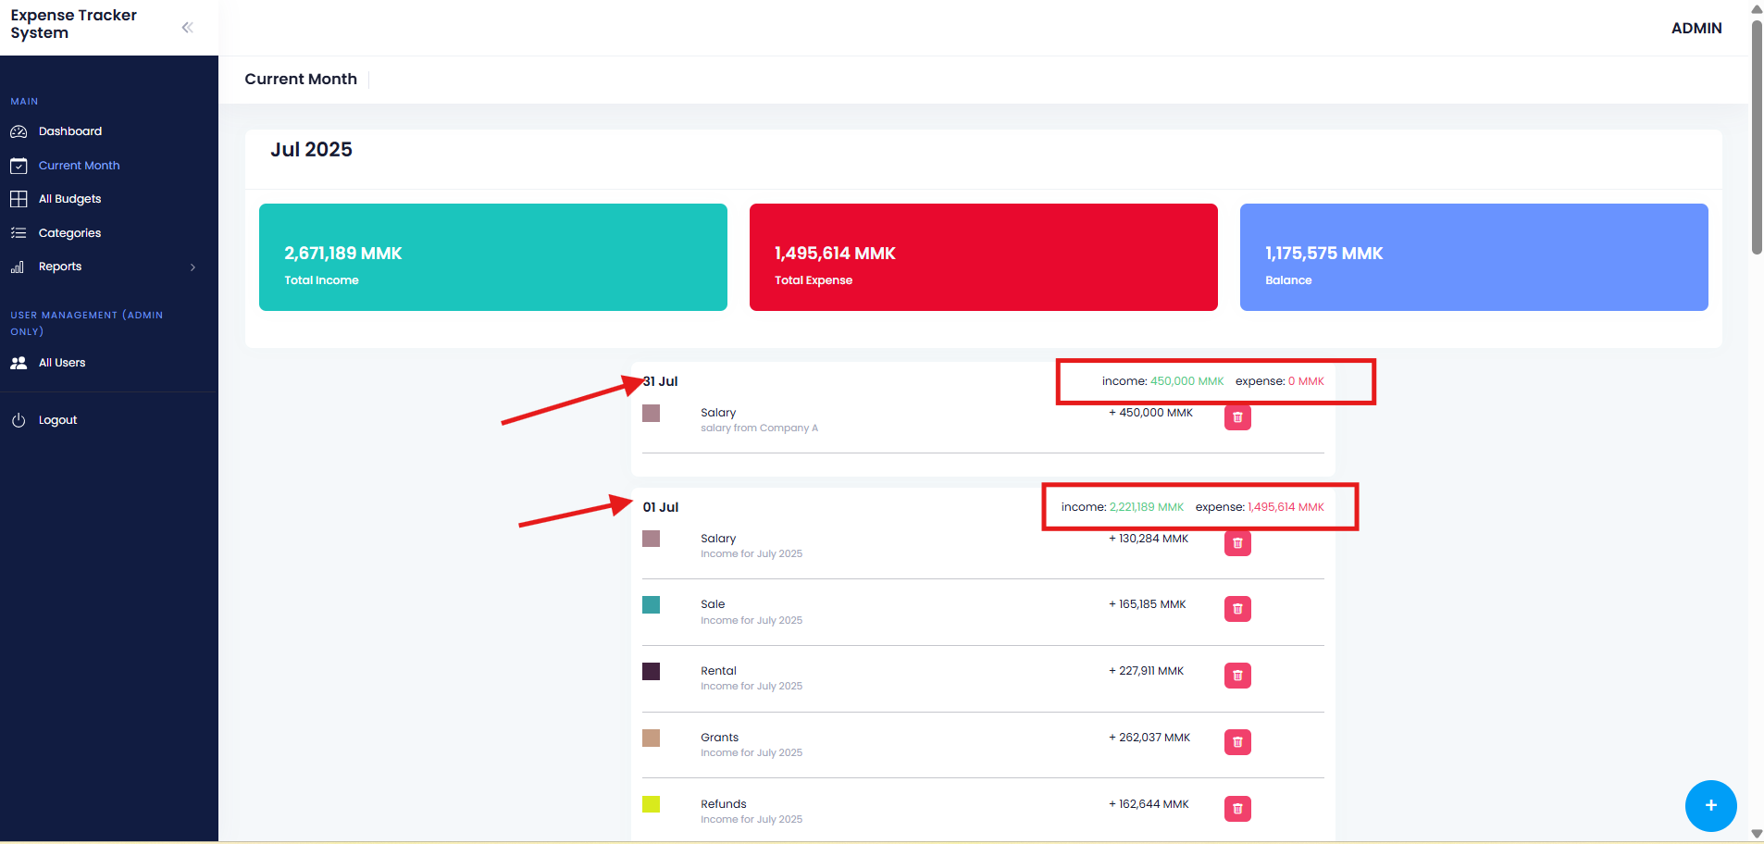
Implementation
Current month report, usage on each day is showed.

Slide 19
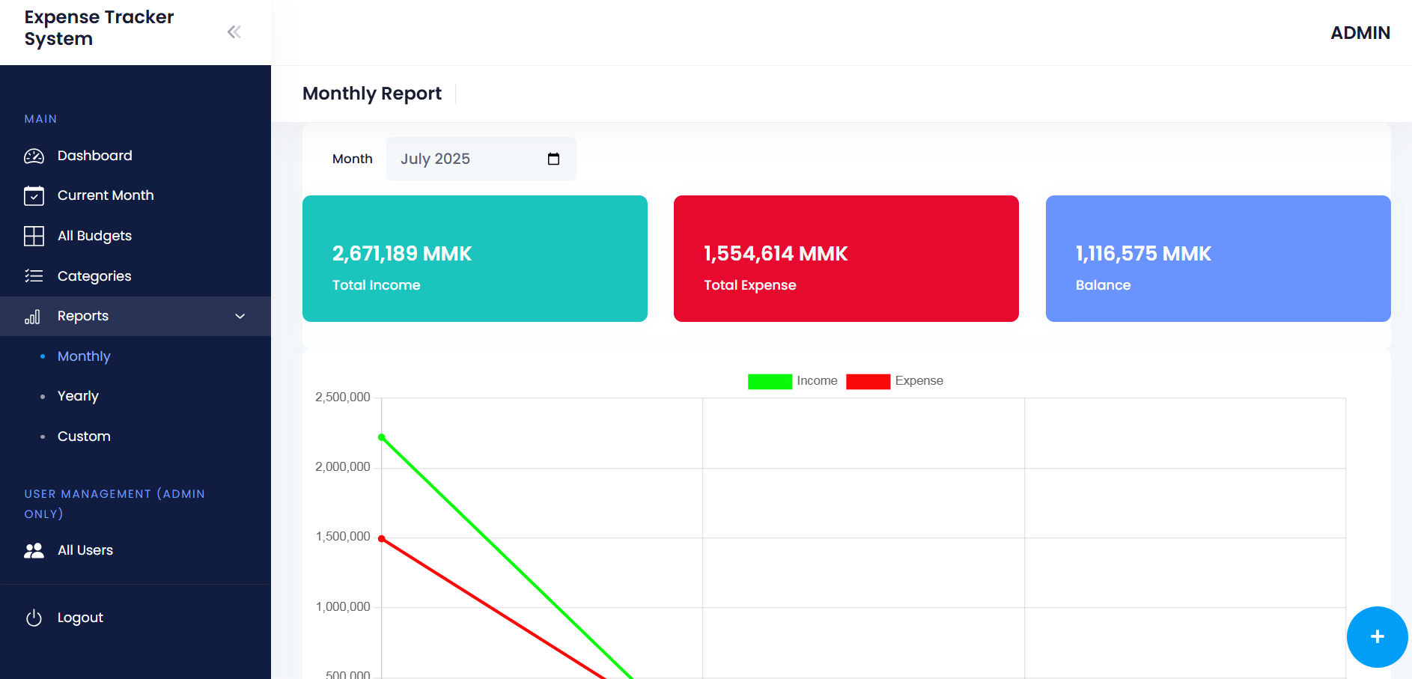
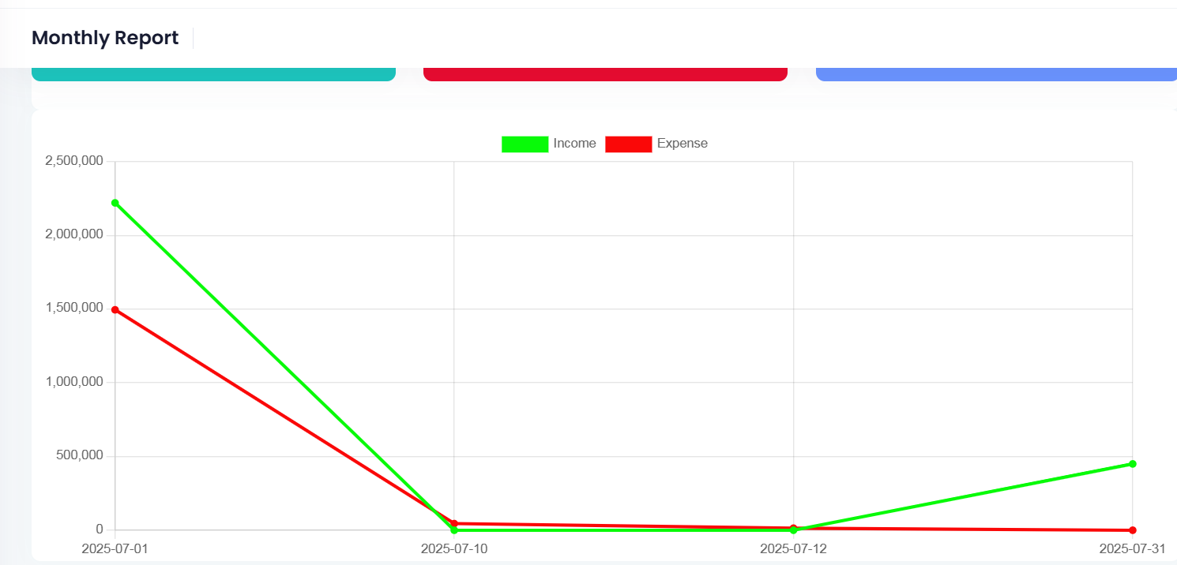
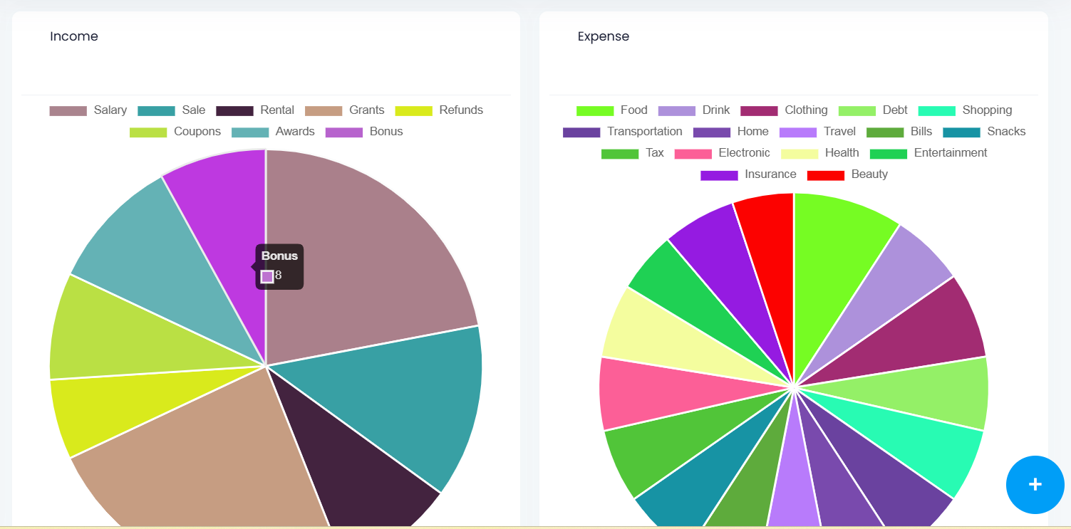
Implementation
Implementation of Report: monthly

Slide 20
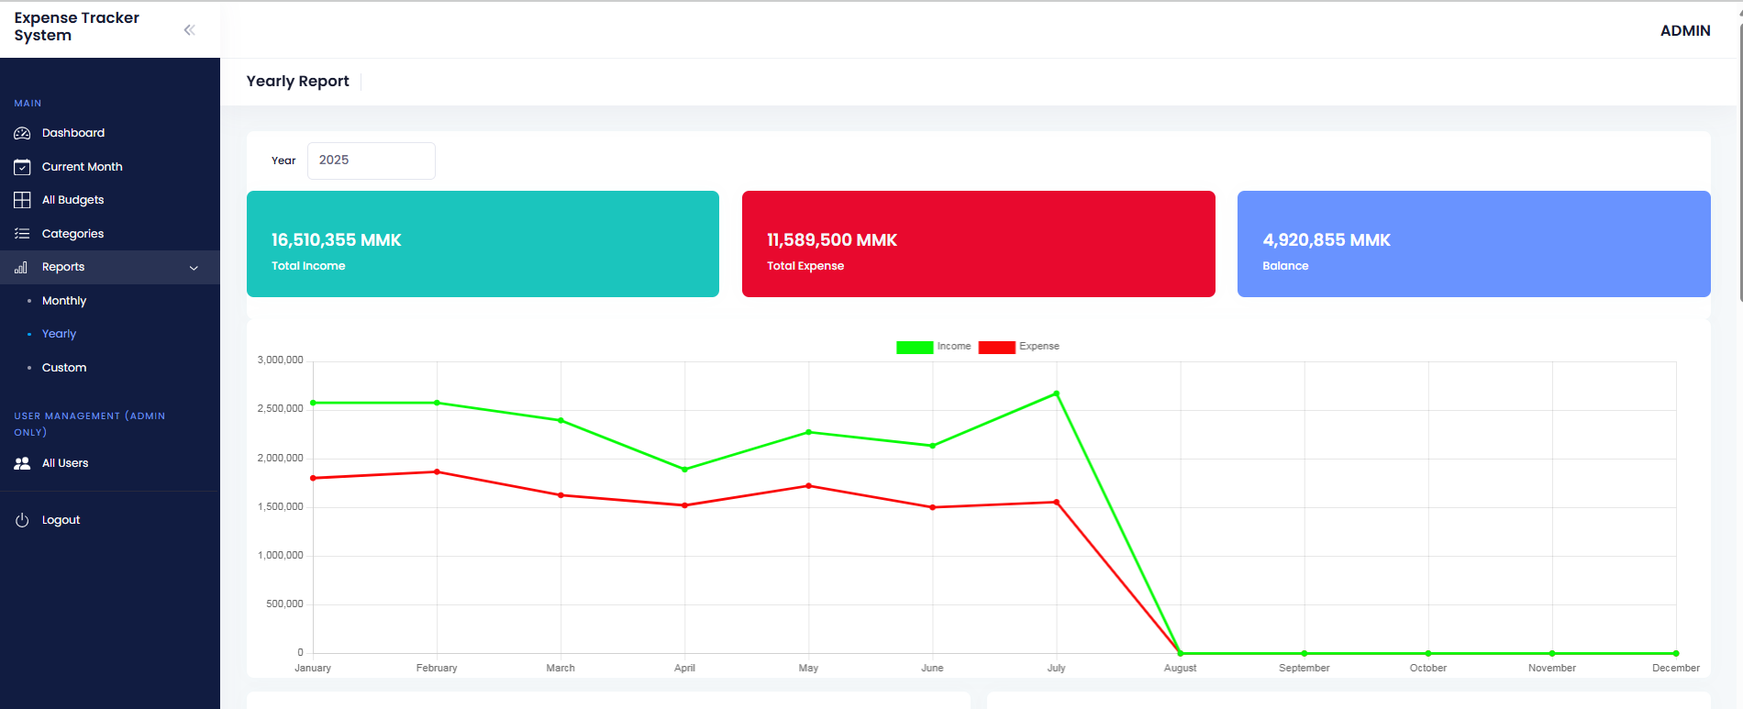
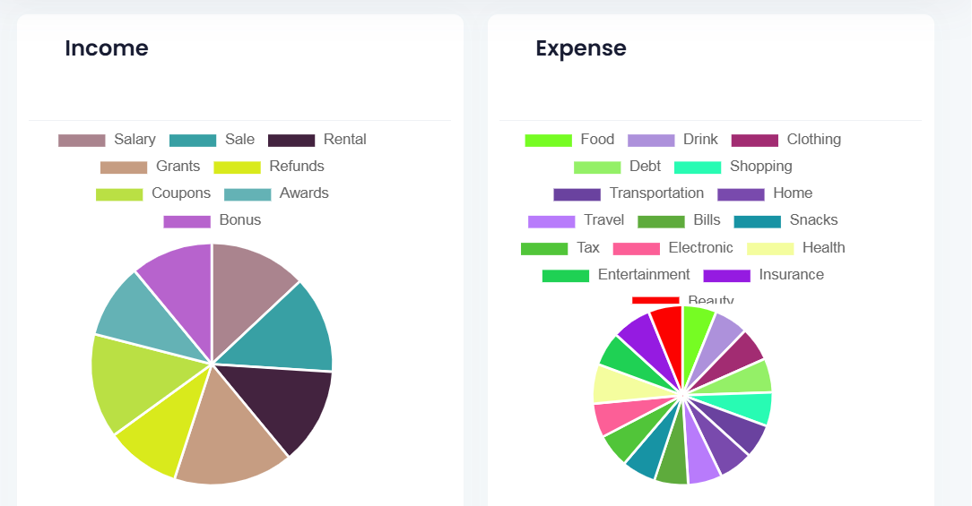
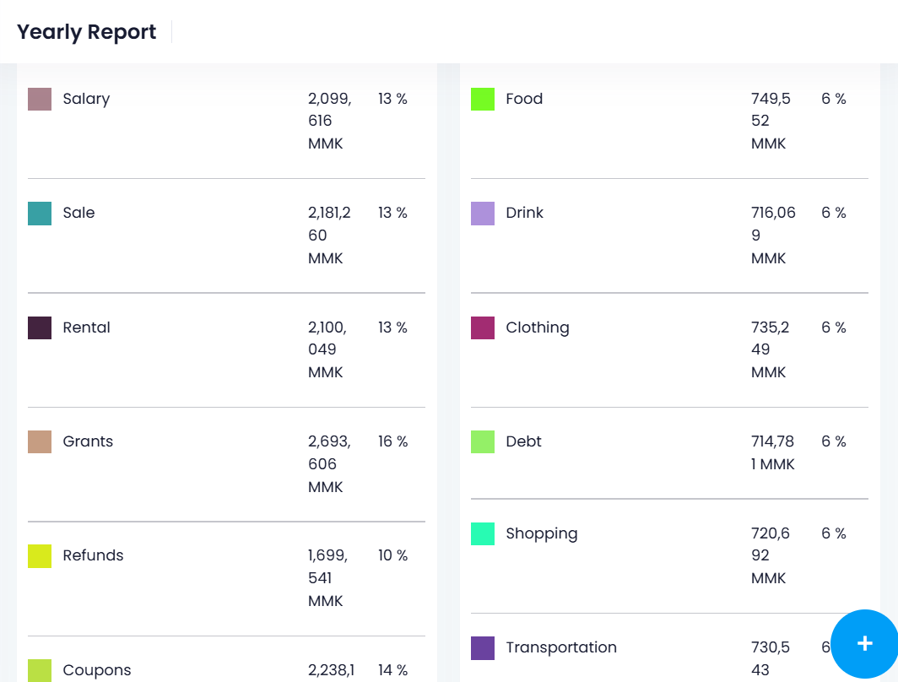
Implementation
Implementation of Report: yearly

Slide 21
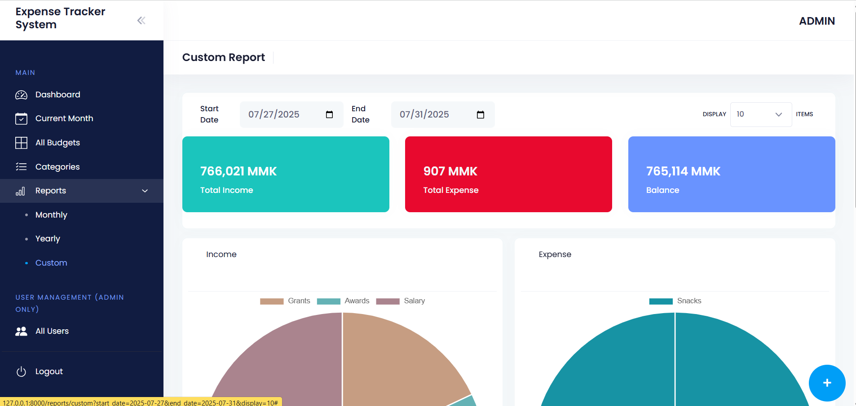
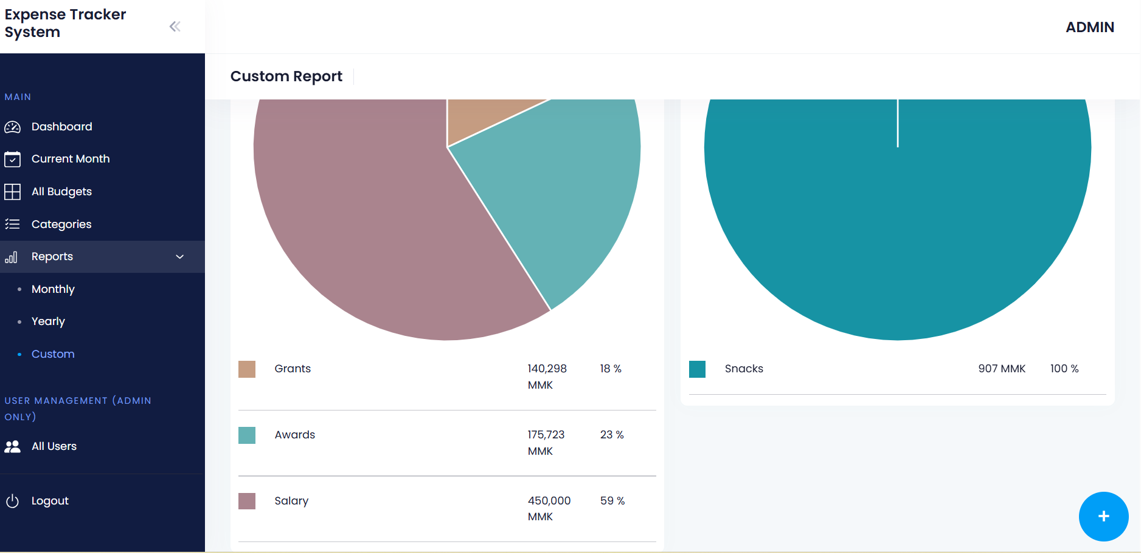
Implementation
Implementation of Report: Custom Dates

Slide 22
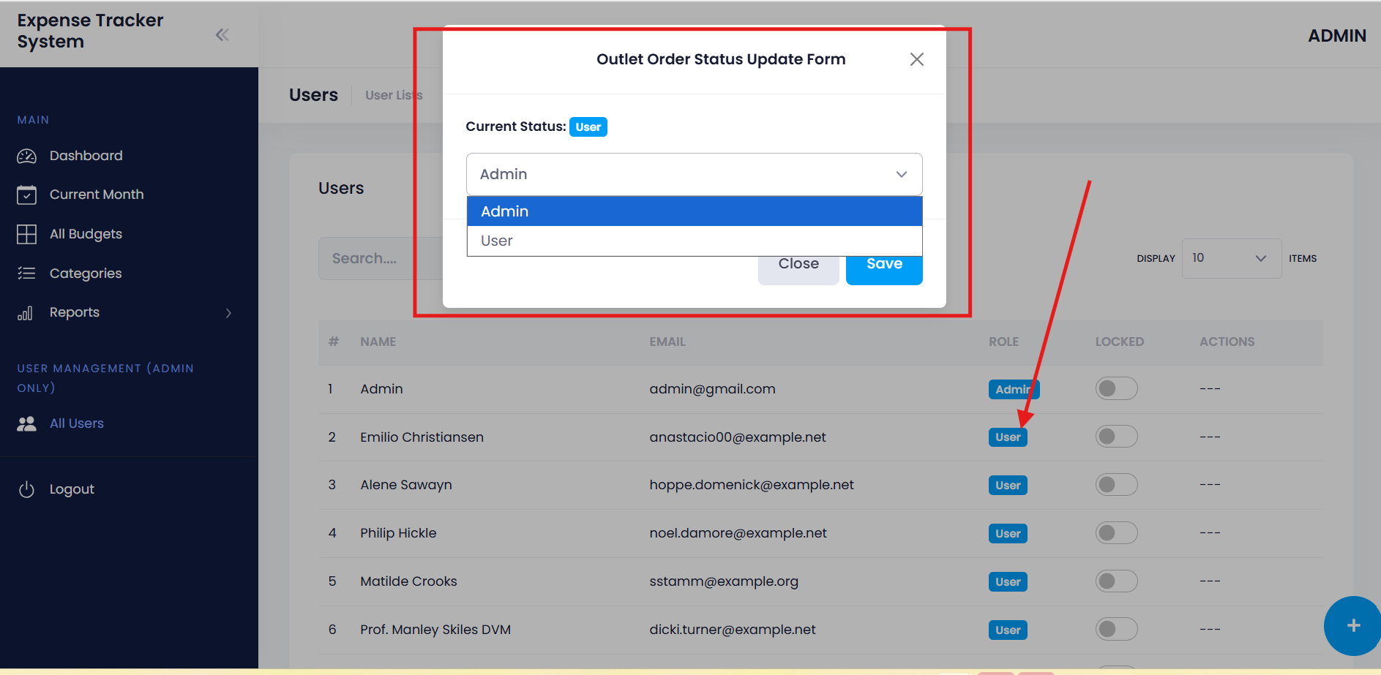
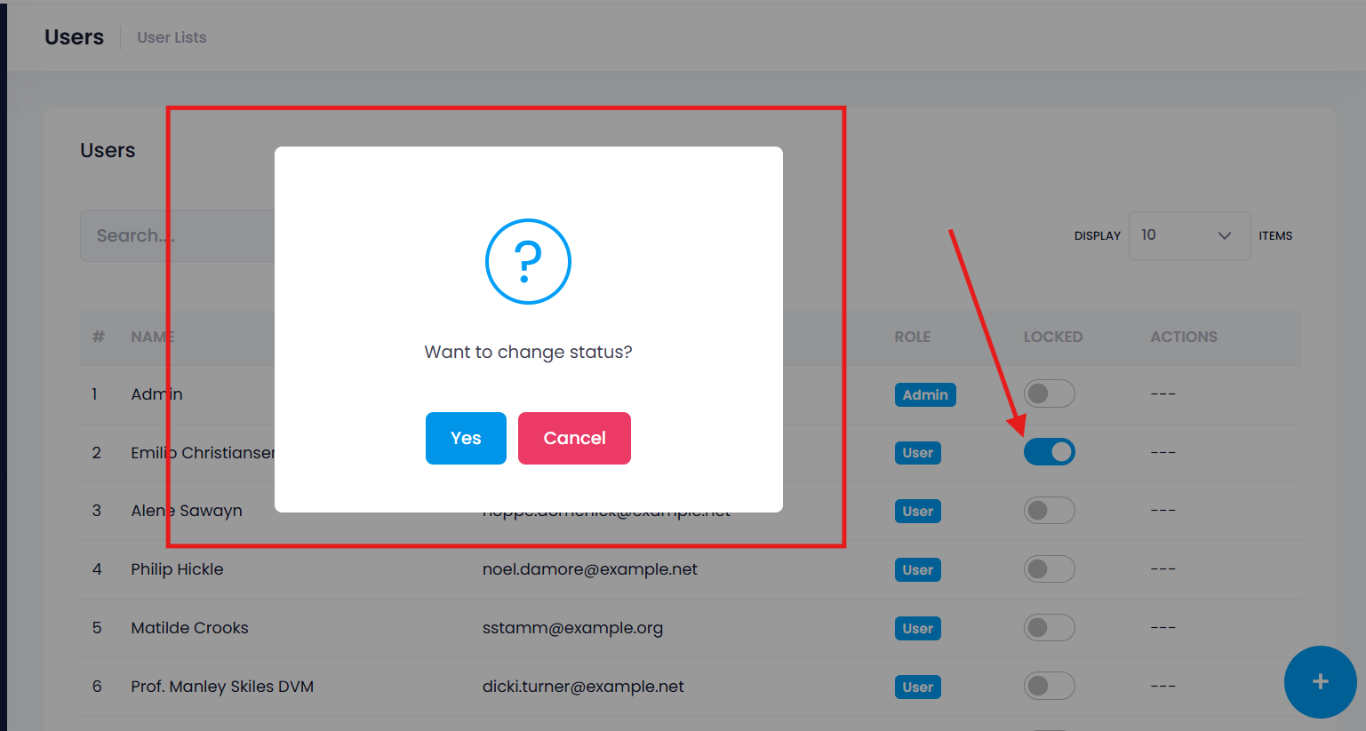
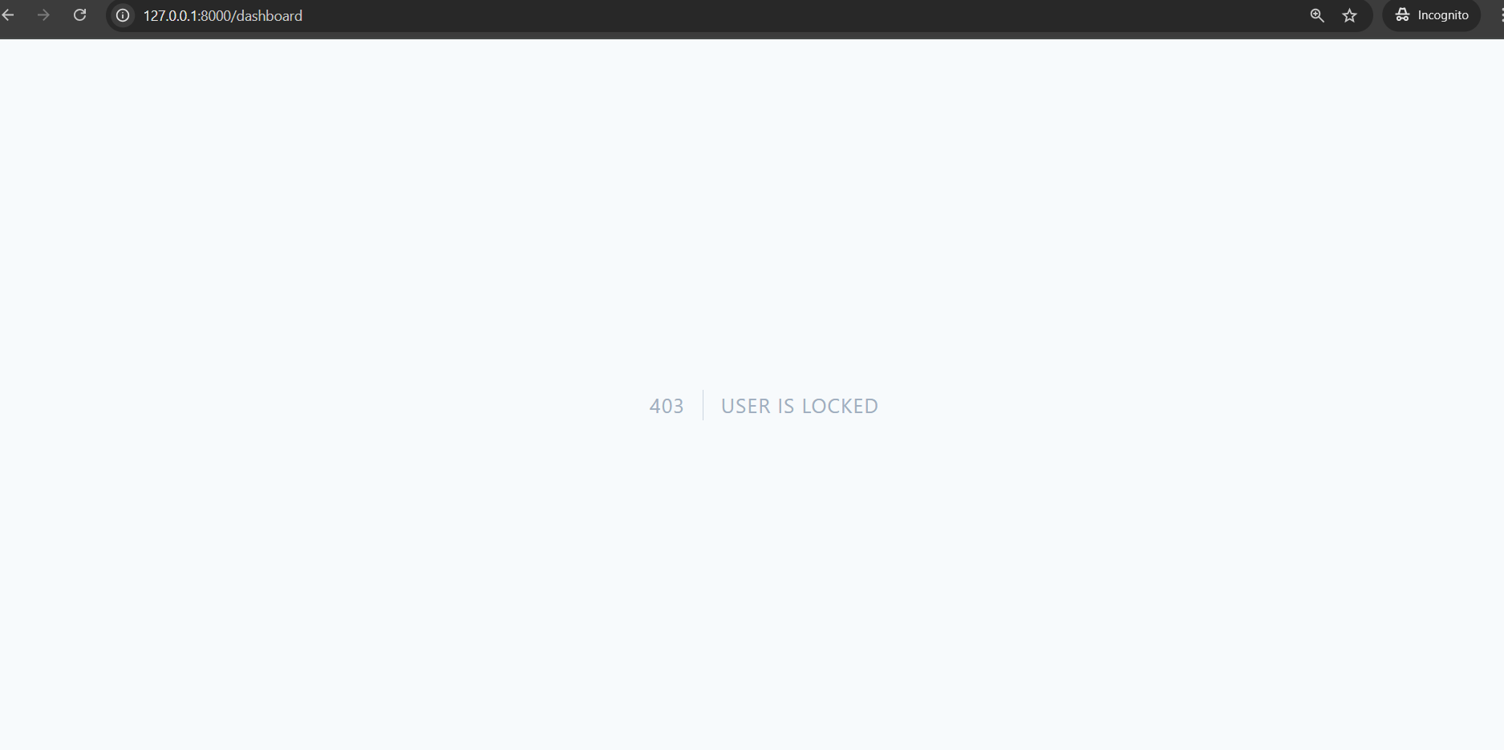
Implementation
User Management For Admin: change roles, lock user

Slide 23
Conclusion
✔ Problem Solved: Eliminates manual expense tracking errors, Provides real-time financial visibility
✔ Key Features Delivered: Interactive dashboards with Line graphs, Pie Charts
✔ Technical Success: Responsive web design (mobile/desktop), Role-based Auth and Efficient Database Queries
✔ User Impact: save time and resources, avoid human errors
✔ Future: Alert system for overcome expenses

Slide 24
Lessons learned
✔ Technical Challenges & Solutions: Database Design, Efficient Queries for Reports, Charts, Authentication and Authorization, Data Validation
✔ User Experience: Mobile-First Reality, Visualize Reports
✔ Project Management: Software Development Life cycle
✔ Personal Growth: Developing a web-based system by feeling an end user

Slide 25
Further Enhancements
✔ Setting for Site Logo, Name: Interactive dashboards with Line graphs, Pie Charts
✔ Setting for limiting expenses: for Overcome usage
✔ Alert for overcome usage
✔ Wallet

Slide 26
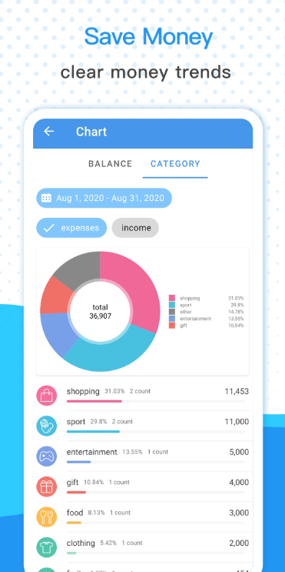
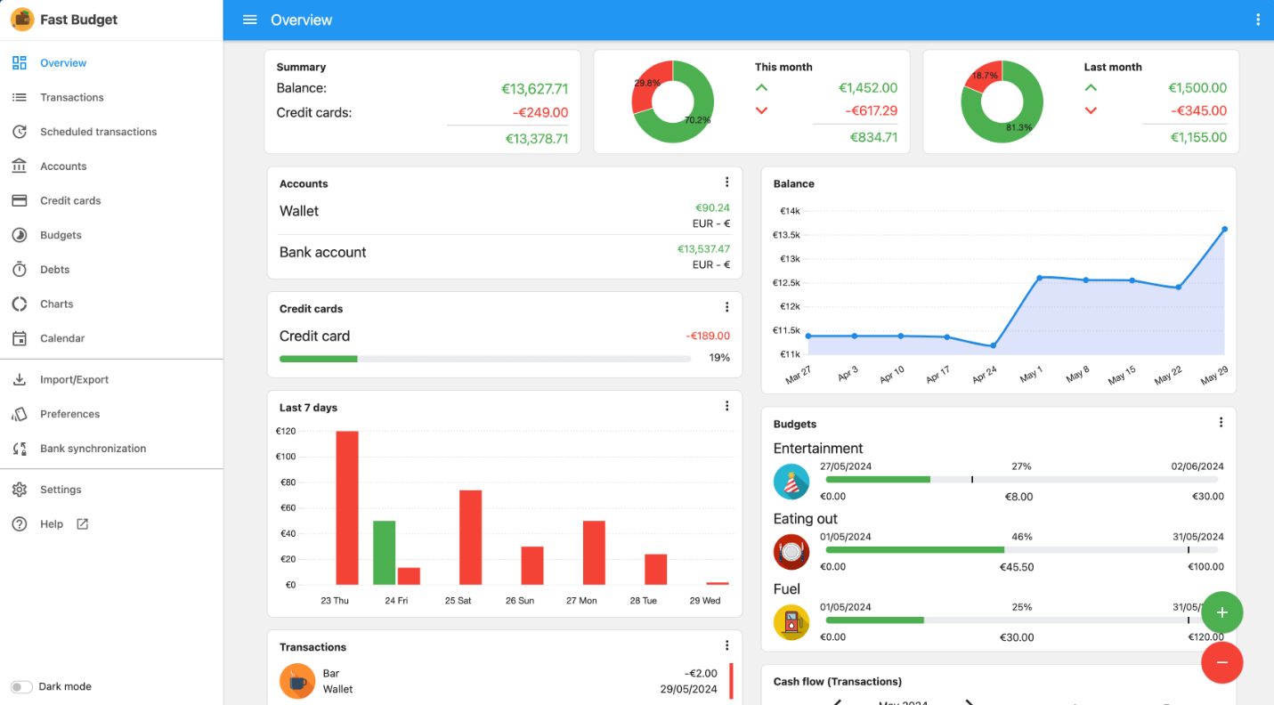
Refences
https://play.google.com/store/apps/details?id=com.hg.moneymanager.budgetapp&hl=en
https://fastbudget.app/

Slide 27
Thank You

